Slide 1
Spark Memory management
ITC Consultants BD-Batch Jan 2023

Slide 2
Prerequisites - Revision
Spark is an in memory processing engine
Keywords like cache and persist
Broadcast concept and its need
Data processing function like JOIN etc.
Spark driver and executor concept

Slide 3
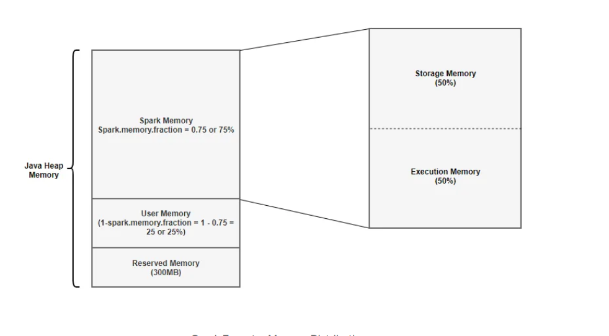
Overview
spark-submit --driver-memory 2g --executor-memory 2G --class work_class app.jar
spark.memory.fraction — defaults to 0.75
spark.memory.storageFraction — defaults to 0.5

Slide 4
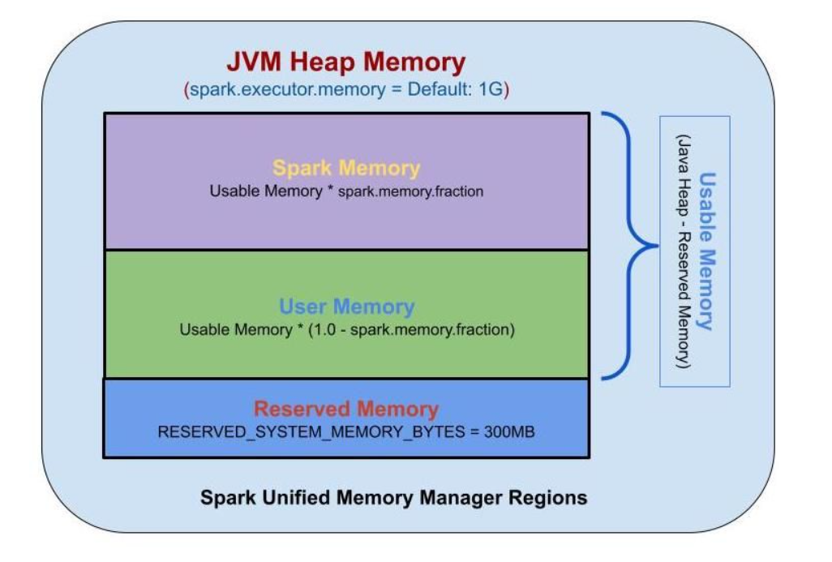

Slide 5
Reserved memory
Memory reserved by spark for internal objects
it is not dependent on tasks to be executed
Its value is 300 MB
If the executor memory is less than 1.5 times of reserved memory, Spark will fail with a “please use larger heap size” error message. This means spark executor must have at least 450 MB

Slide 6
User memory
Memory area that stores all the user defined data structures, any UDFs created by the user etc.
This memory segment is not managed by spark, spark will not be aware of/maintain this memory segment.
Its responsibility of YARN resource manager if YARN is used as cluster manager
The size of this memory segment is equal to (Java Heap — Reserved Memory) * (1.0 — spark.memory.fraction),
By default :- User memory = (Java Heap — 300MB) * 0.25.

Slide 7
Spark memory
This memory segment is managed by spark execution engine
Calculated by following formula: (Java Heap — Reserved Memory) * spark.memory.fraction
Spark memory has two segments
Storage memory (Java Heap — Reserved Memory) * spark.memory.fraction * spark.memory.storageFraction
Execution memory

Slide 8
Storage memory
Used to cache partitions of data
Used to store data with Persist having persistance level MEMORY in it
Used to store broadcast data
Used to store unroll data
Spark clears space for new cache requests by removing old cached objects based on Least Recently Used (LRU) mechanism.
Once the cached data it is out of storage, it is either written to disk or recomputed based on configuration.
Broadcast data is also written with MEMORY_AND_DISK persistent levels

Slide 9
Execution memory
Execution Memory is used for storing the objects required during the execution of Spark tasks.
Store hash table for hash aggregation step during JOINs
Store shuffle intermediate buffer on the Map
Execution memory tends to be more short-lived than storage.
It is evicted immediately after each operation, making space for the next ones.
The blocks from this pool cannot be forcefully evicted by other tasks.
This means this segment also supports spilling on disk if not enough memory is available.

Slide 10
Storage vs execution memory
There is no hard boundary between Execution memory and Storage memory.
Both storage and execution memory can borrow space from each other.
In this memory borrowing relation Execution memory has preference.

Slide 11
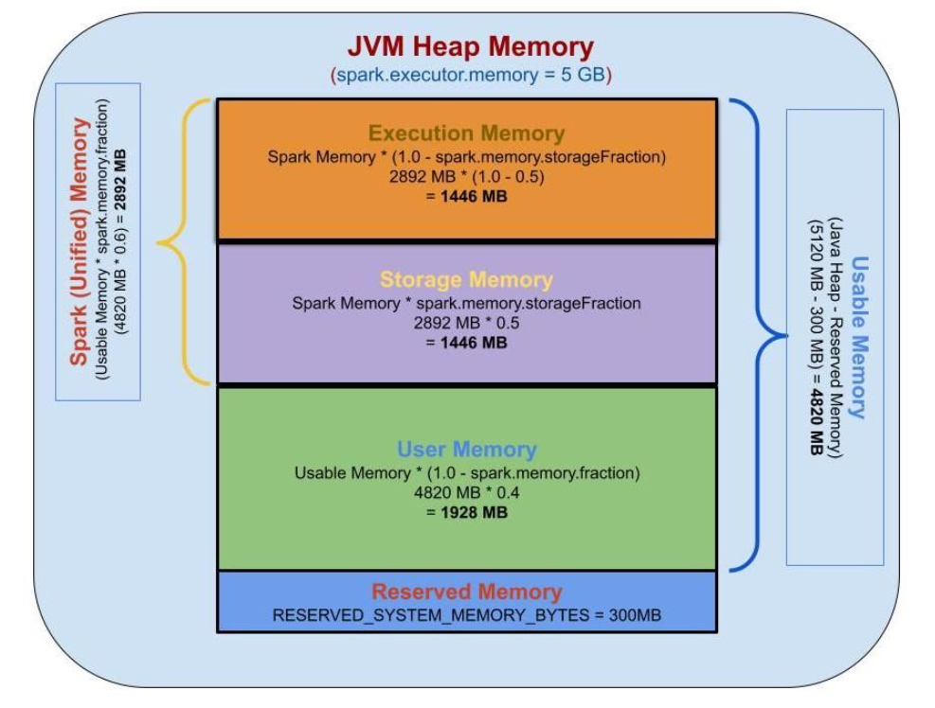
Spark memory example

